Slide 1
AR on the influence of Gamification on learning IELTS writing skills
Michelle Ocriciano
m.ocriciano@unswglobal.unsw.edu.au
michelle.ocriciano@gmail.com

Slide 2
AR on the influence of Gamification on learning IELTS writing skills
Michelle Ocriciano
m.ocriciano@unswglobal.unsw.edu.au
michelle.ocriciano@gmail.com

Slide 4
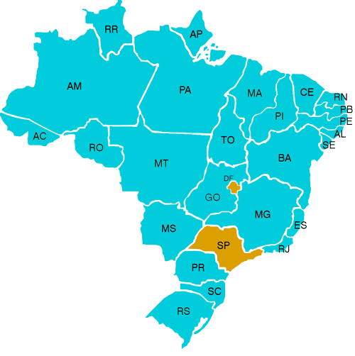

Slide 5
Action Research in ELICOS Program
English Language Intensive Courses for Overseas Students

Slide 6
How many people play games on a daily basis?

Slide 7
Do you play any type of video game on a regular basis?
100%

Slide 8
“Gamification has become an essential part of any digital business strategy as a way of digitally motivating people and overcoming barriers of scale, time, distance, connectedness and cost. It is being used to add value to the product offer, to increase employee engagement and to drive crowdsourced innovation.” Gartner 2014
“From all the strategies that exist, Gamification is one that constantly promotes motivation.” Flores 2015

Slide 9
The main objective of gamification is to increase participation and to motivate users through the use of game elements. Essentially, any activity, task, or assignment could be gamified. In order to gamify a task, it is important to consider the elements or components in gamification such as points, leaderboards, and immediate feedback among other things.

Slide 10
It’s the application of typical elements of game playing (e.g. point scoring, competition with others, rules of play) to other areas of activity.

Slide 12
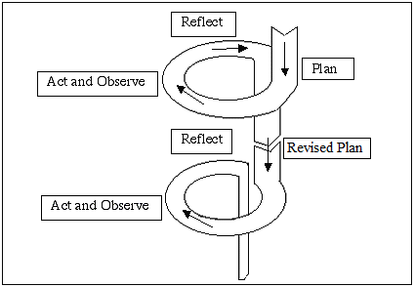
What is Action Research?
Action research is simply a form of self-reflective enquiry undertaken by participants in social situations in order to improve the rationality and justice of their own practices, their understanding of these practices, and the situations in which the practices are carried out (Carr and Kemmis 1986: 162).

Slide 13
Characteristics of AR
• Systematic – adopting more than an experiential/intuitive approach to teaching
Professor Anne Burns
• Interventionist – deliberately seeking ways to make teaching/learning effective
• Evidence-based – collecting evidence to support claims about what is happening
• Critically reflective – being open-minded and responsive to what the data show

Slide 14
Research Question
How can Gamification applied to a Moodle setting influence learning IELTS writing skills?

Slide 15
Context and Participants
1
2
3
4
19 students
15 students
15 students
15 students
Venezuela
Poland
Peru
Germany
Switzerland
Thailand
Colombia
South Korea
Brazil
Saudi Arabia
Italy
Lithuania
Spain
China
Brazil

Slide 16
Intervention
*Badge selection
*Initial writing task
*General information about IELTS writing
*In-class activities
*Computer lab Moodle platform
*Digital tracking
*Focus group
*Final writing task
*Interview and feedback

Slide 17
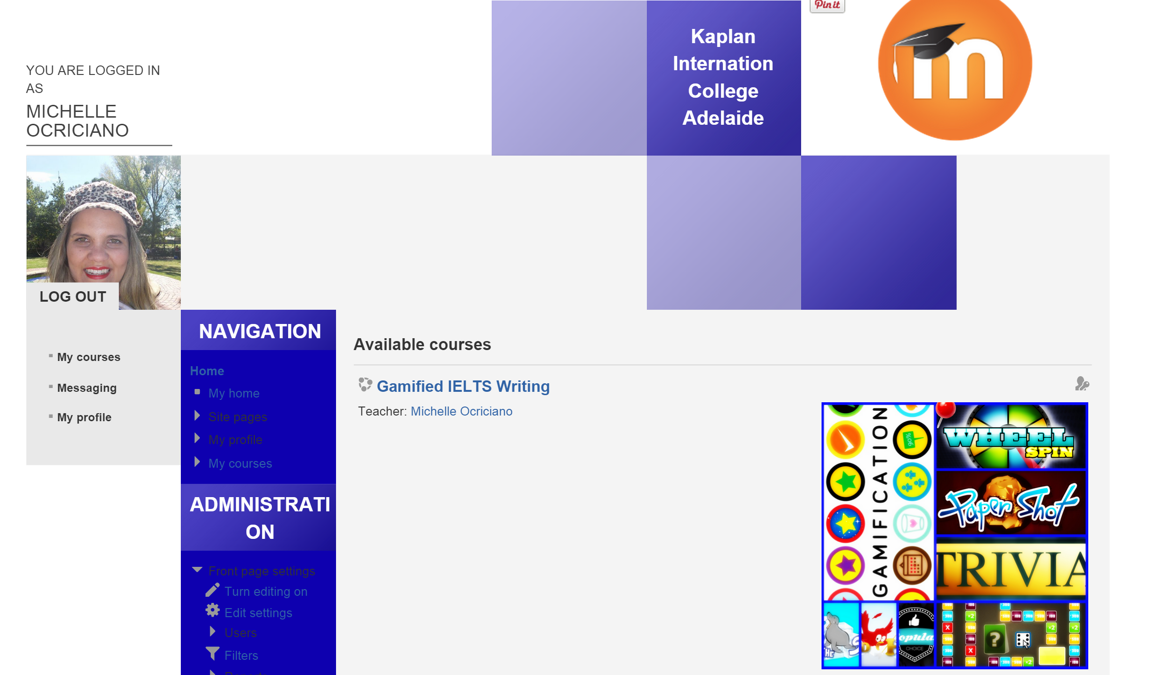
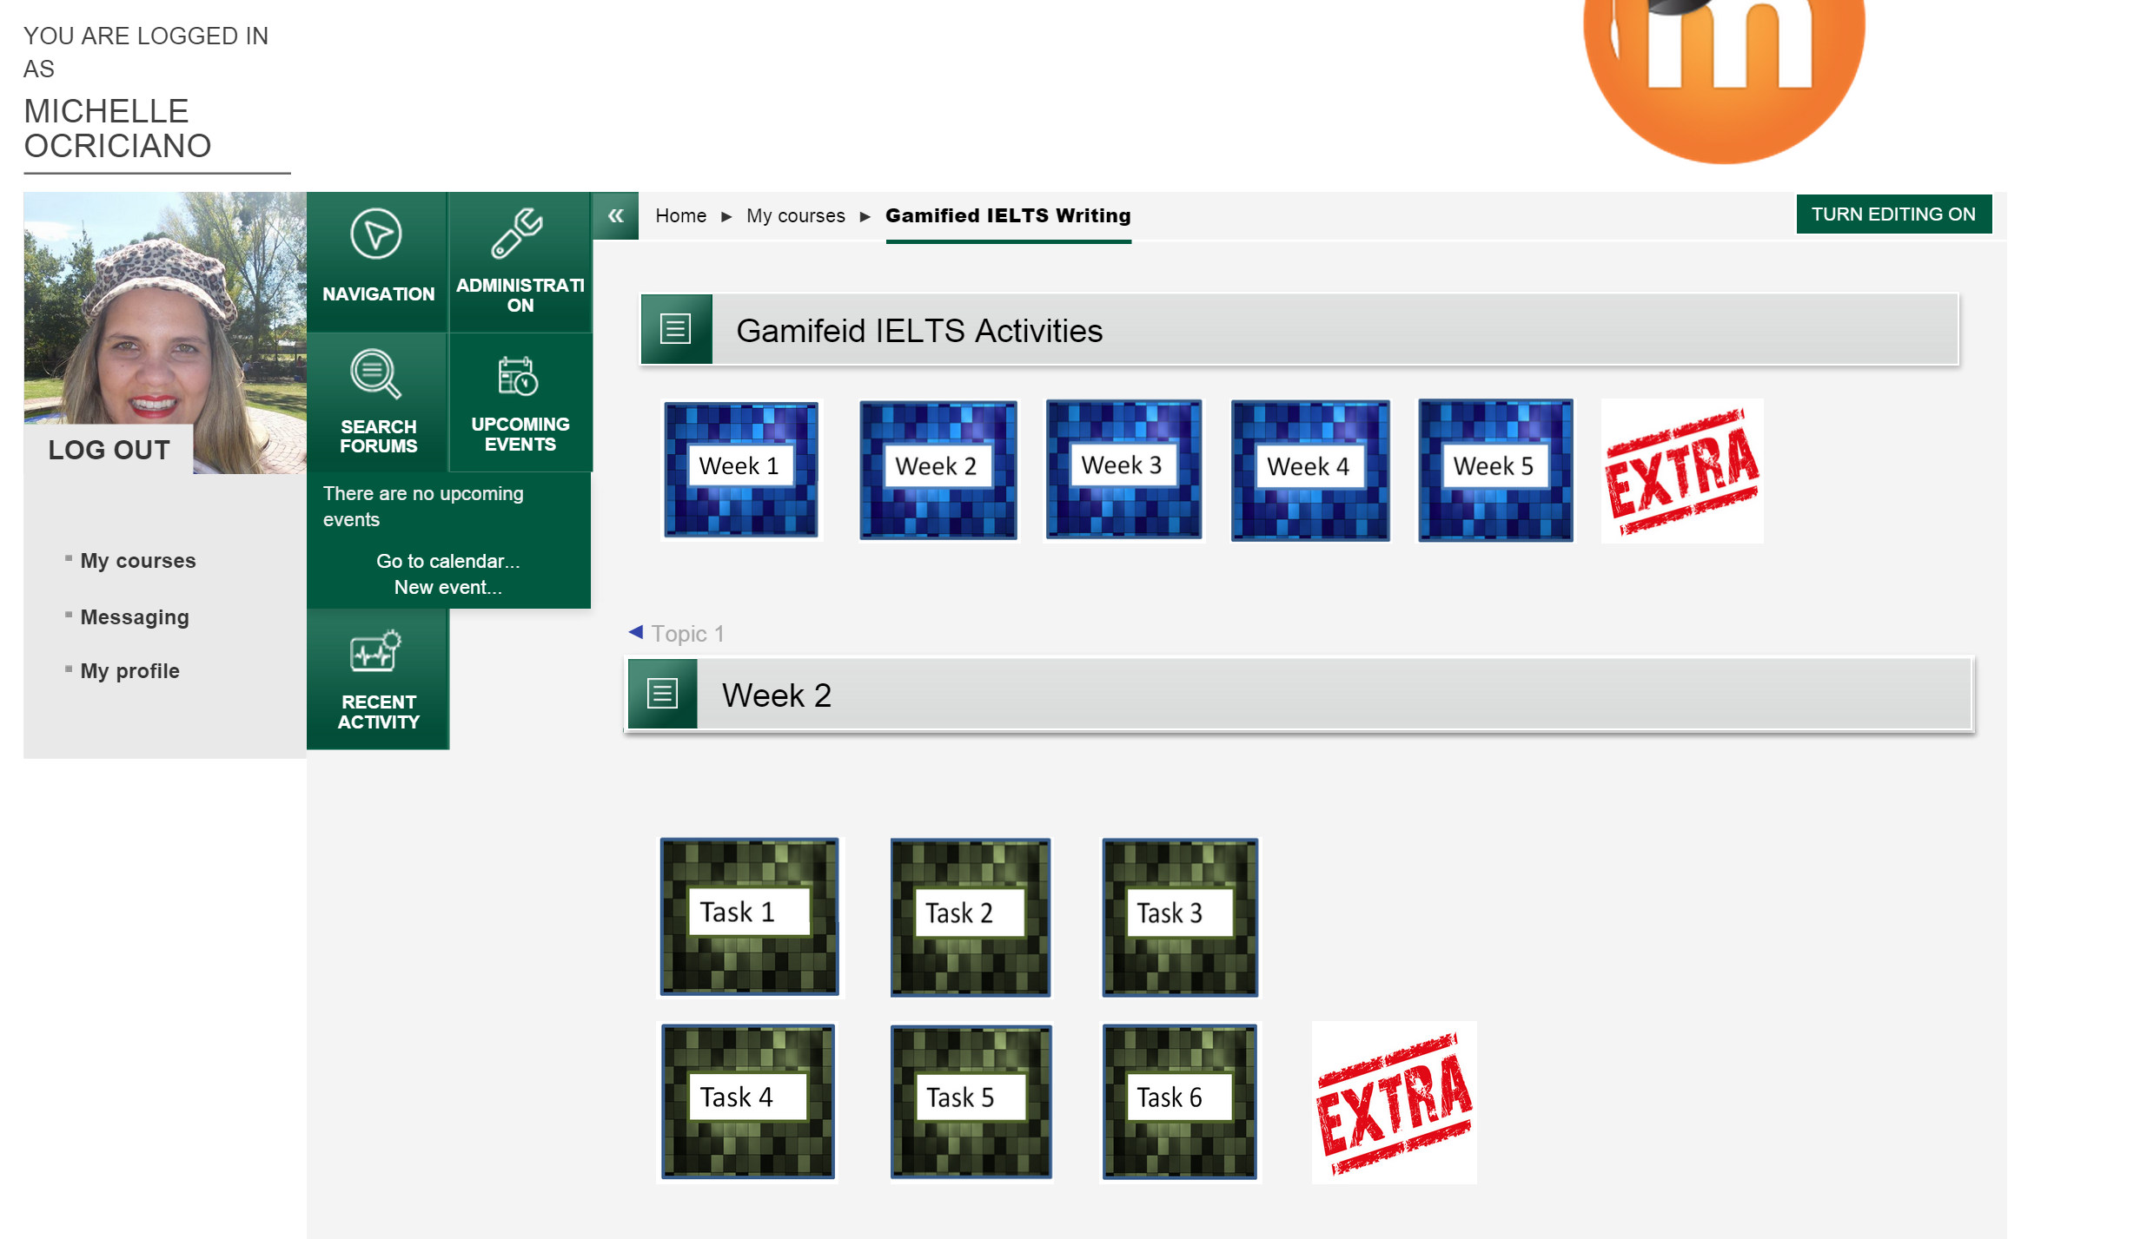
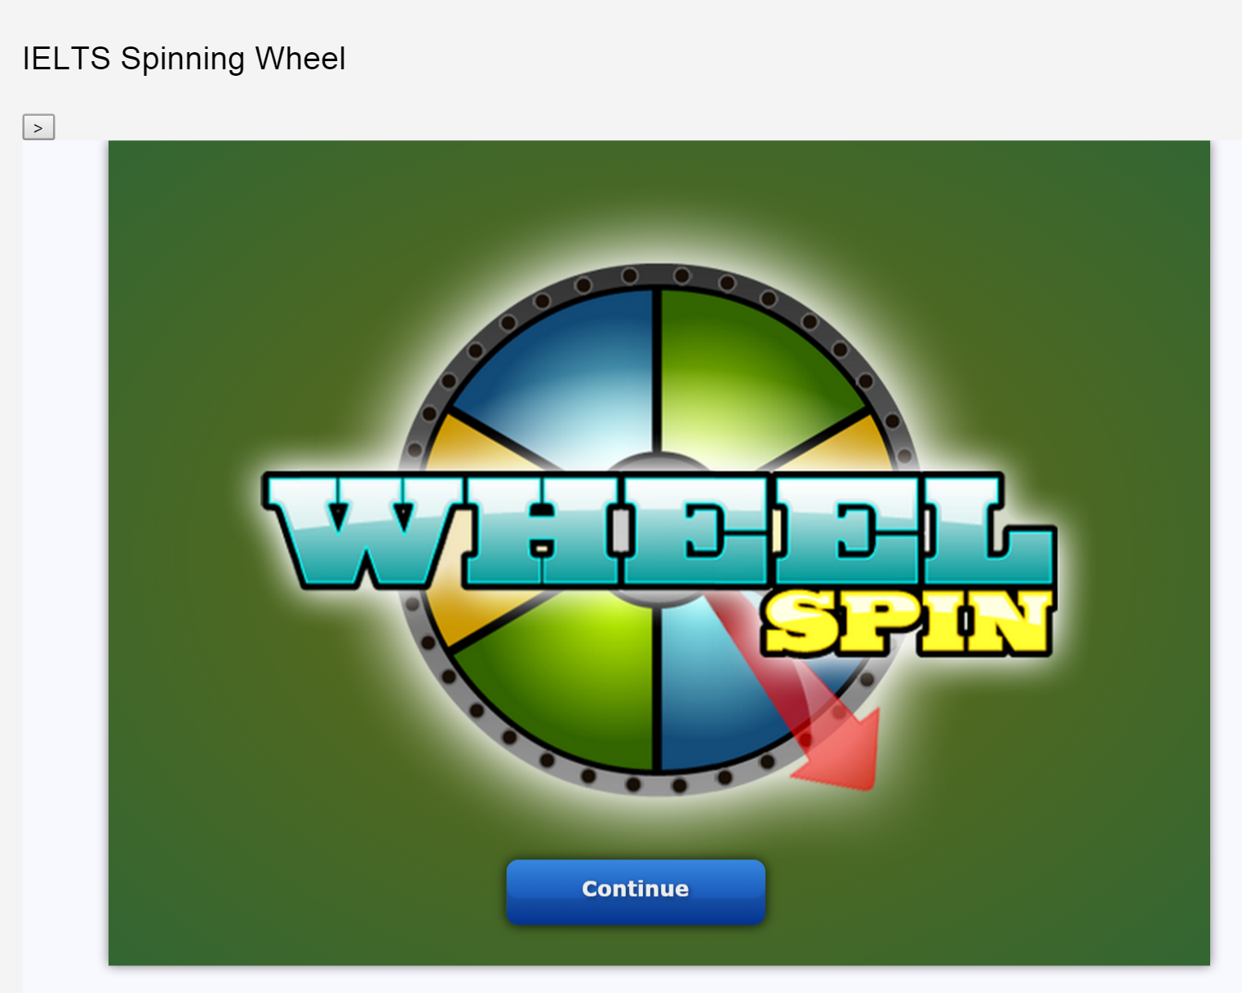
The Platform

Slide 18
DATA COLLECTION
Initial and final writing tasks
Teacher observation Journal
Focus groups
Digital tracking
Follow-up interviews

Slide 19
Results
motivated students
engaged in the activities
spelling improved dramatically
less repetitive vocabulary
writing time reduced
Demotivated
Unfocused
No goals
Bored

Slide 20
The Unexpected
Feedback was incredibly more effective
Students used social media to communicate
They socialized more
They shared teacher’s feedback
They created their own games!

Slide 21
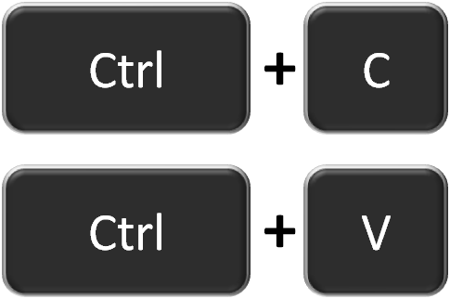
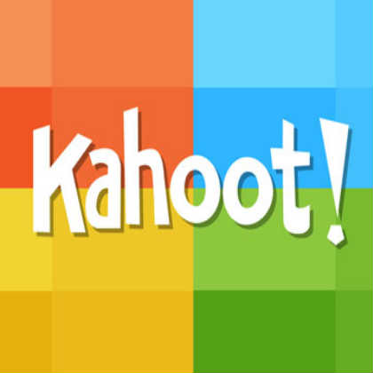
Replicability

Slide 22
Do you have to teach vocabulary?
Do you have a list of words?

Slide 23
HOW TO USE THE TOOLS
Word + Definition
Word + Preposition
Word + Word Form
Word + Past Participle
Word + Synonym(s)
Word + Word Class
Word + Antonym
Word + Translation
Word + Pronunciation
Topic + Word

Slide 24
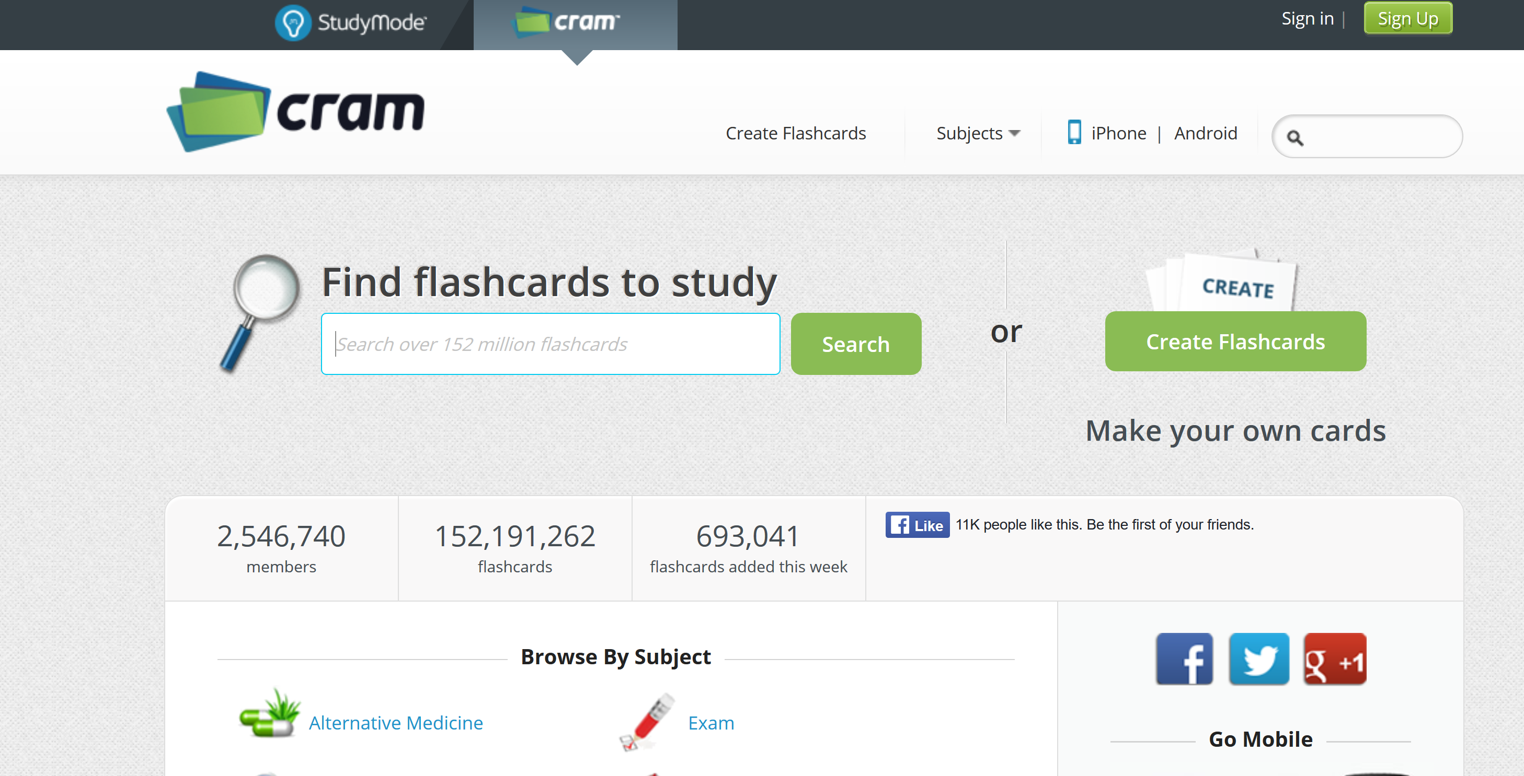

Slide 27
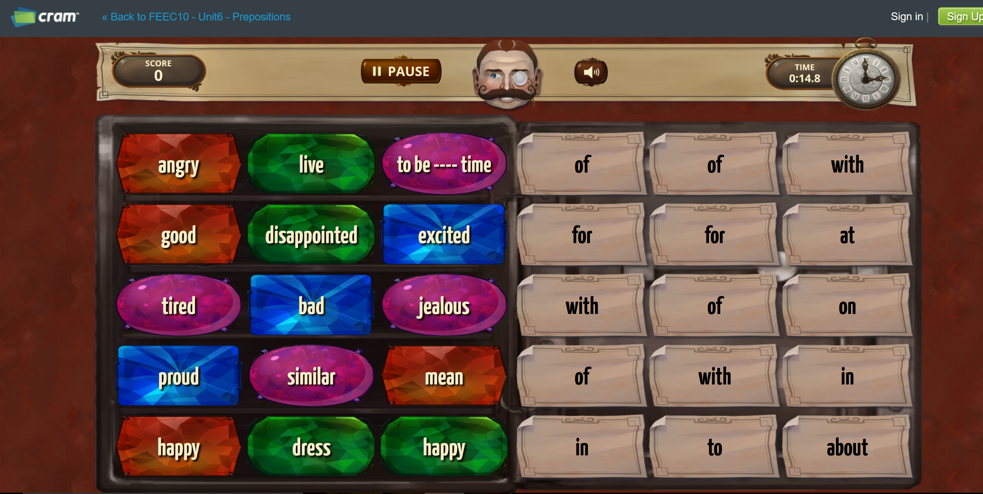
http://www.cram.com/flashcards/games/jewel/feec10-unit6-prepositions-6485739

Slide 28
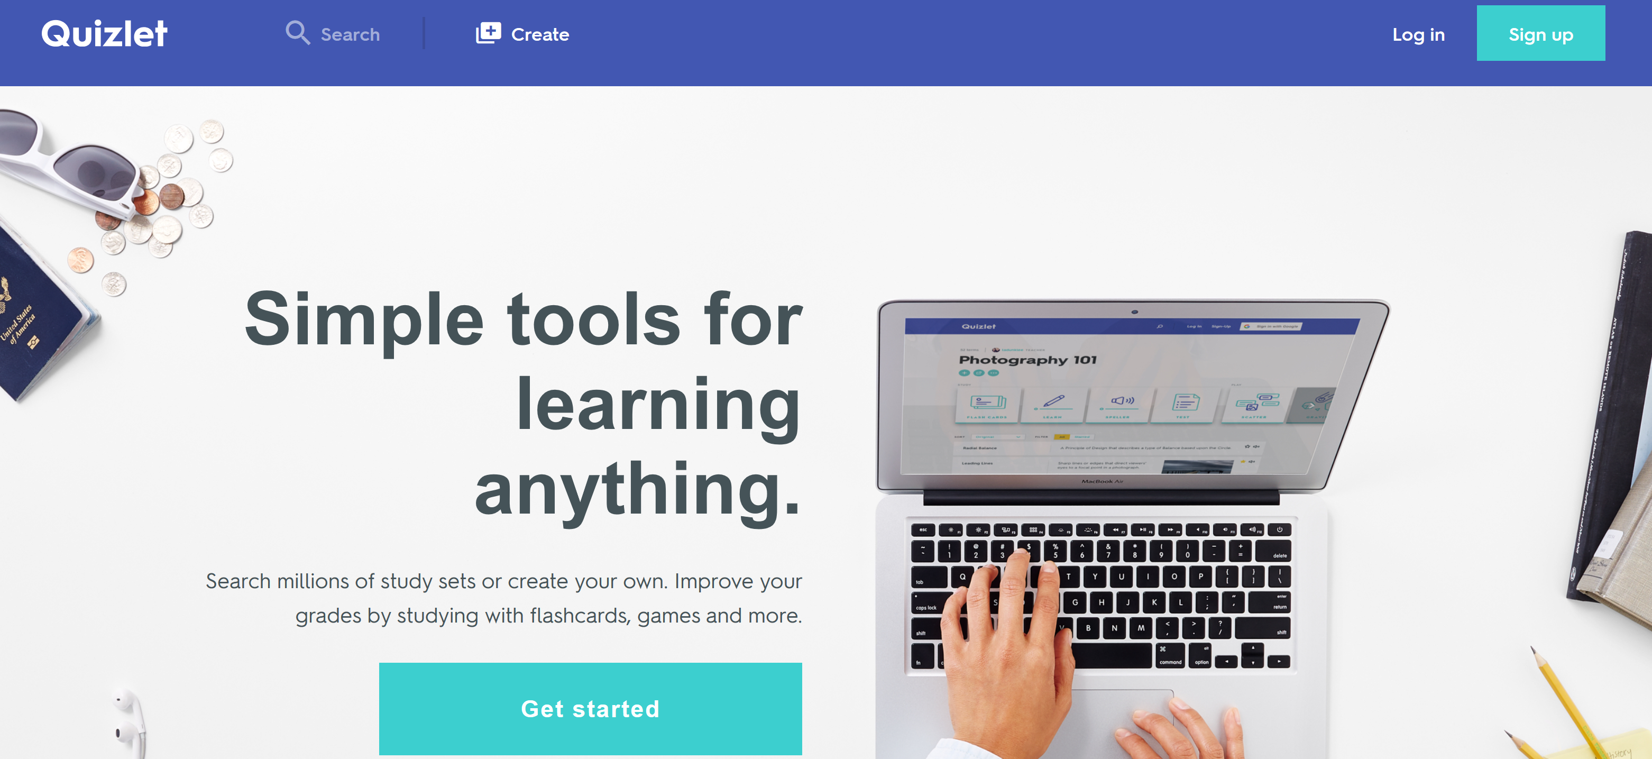

Slide 29
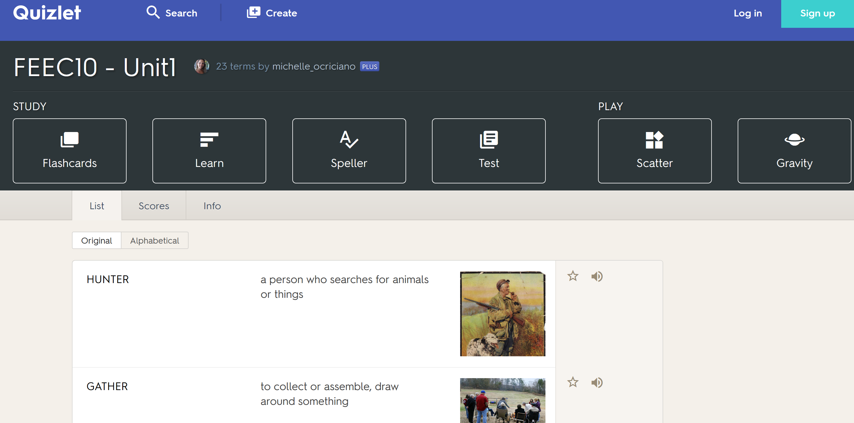

Slide 30
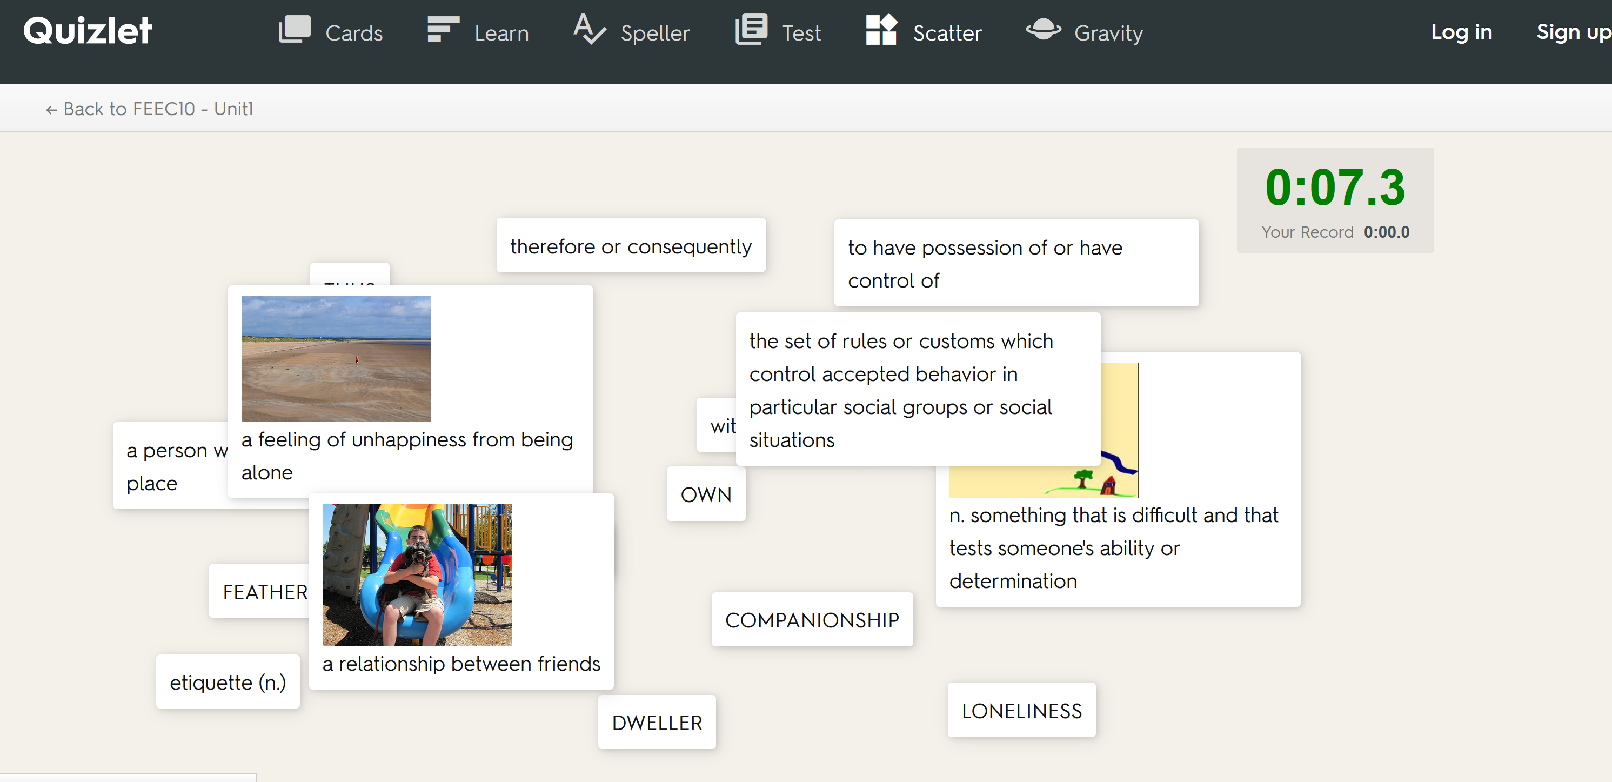

Slide 31
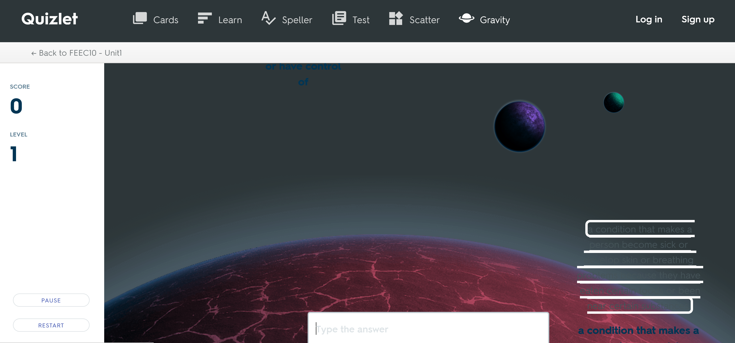

Slide 34
http://www.classtools.net/mob/quiz_84/FEEC10__Unit1__UECA_PD_Fest_6UAUH.htm http://www.classtools.net/wordshooter/quiz84_FEEC10Unit1UECAPDFest6UAUH

Slide 35
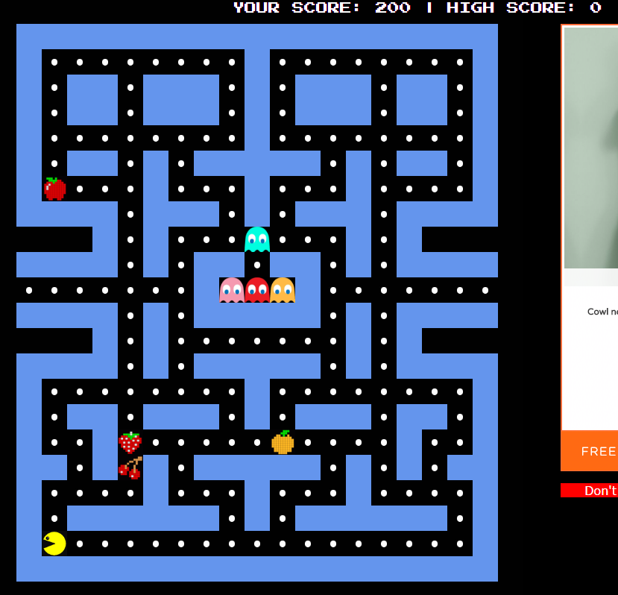

Slide 38
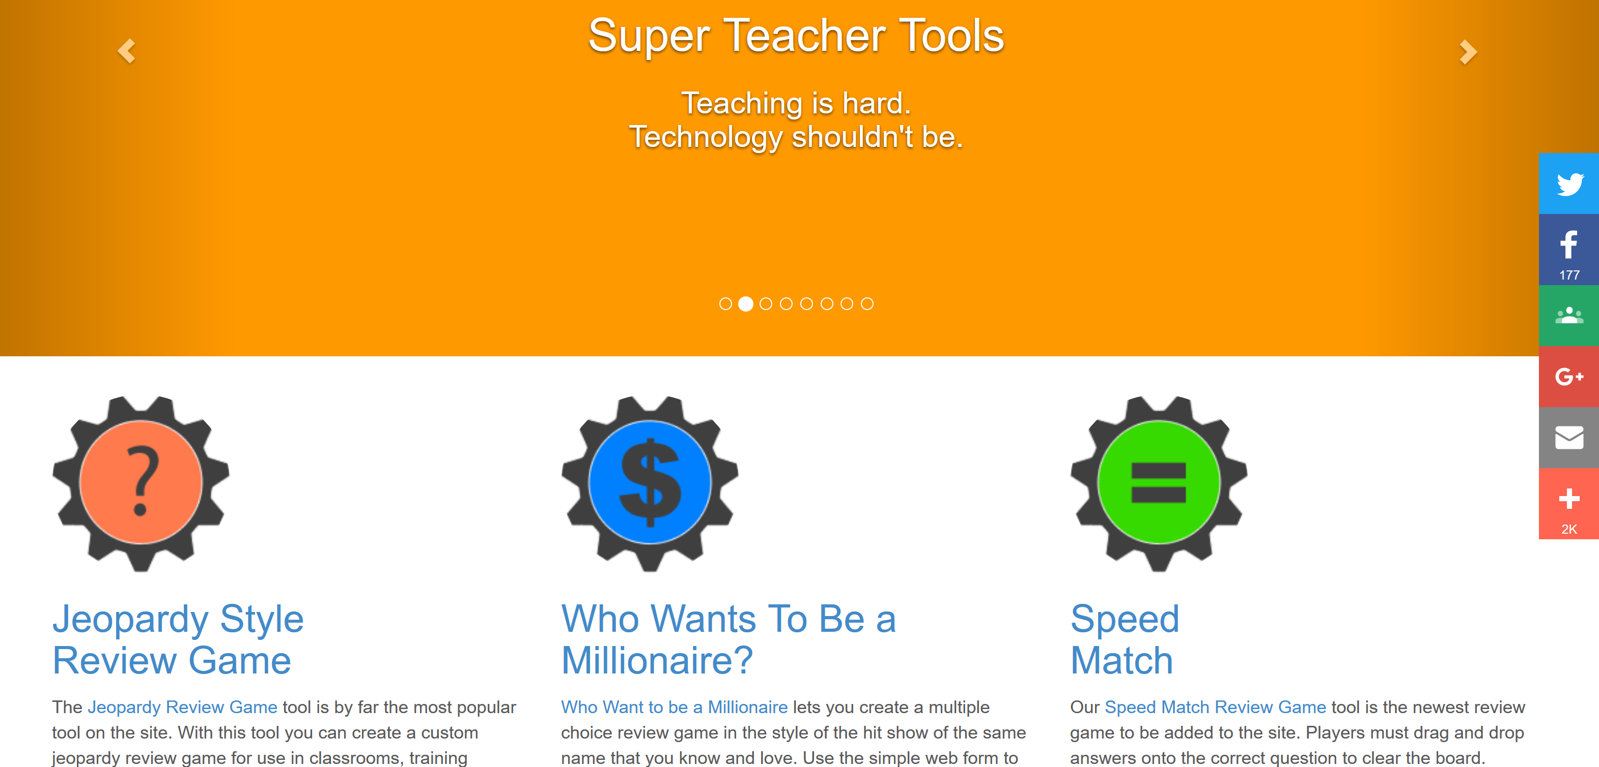

Slide 39
goo.gl/G2D9VK

Slide 41
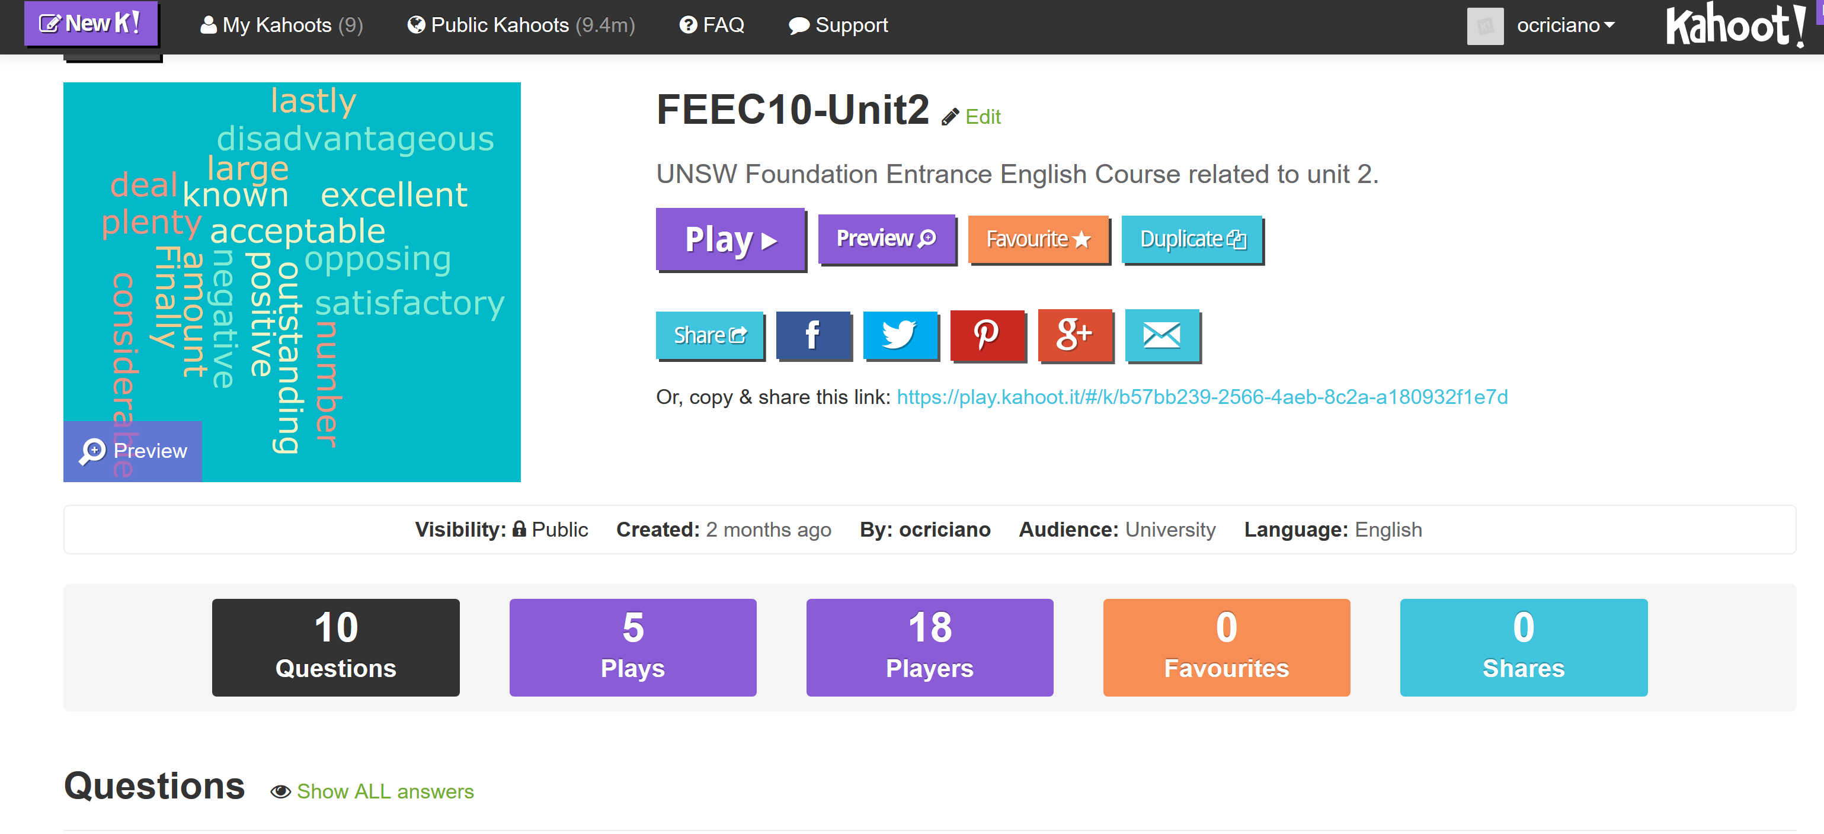

Slide 42
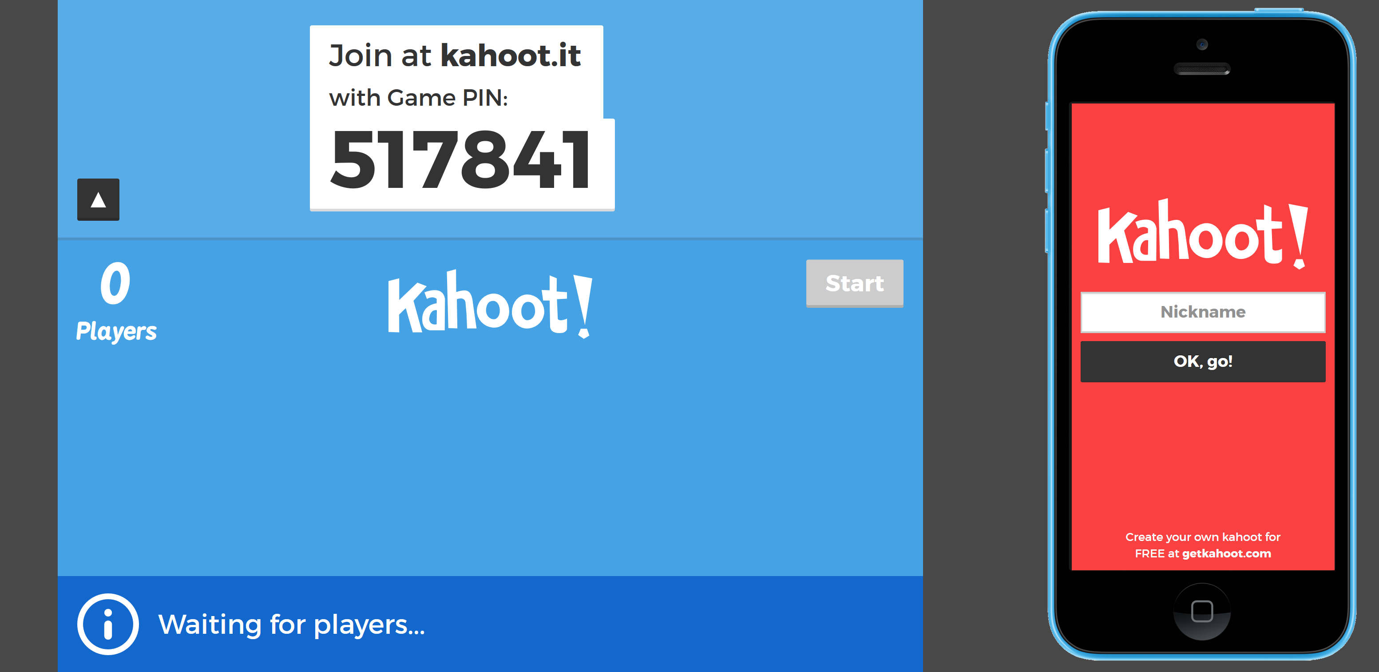

Slide 43
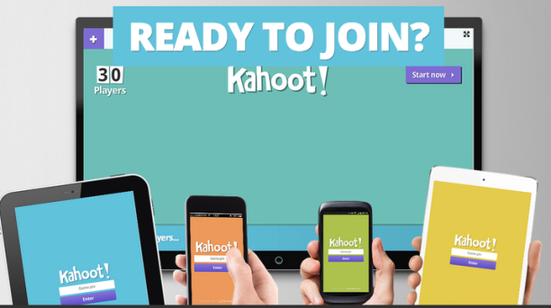

Slide 45
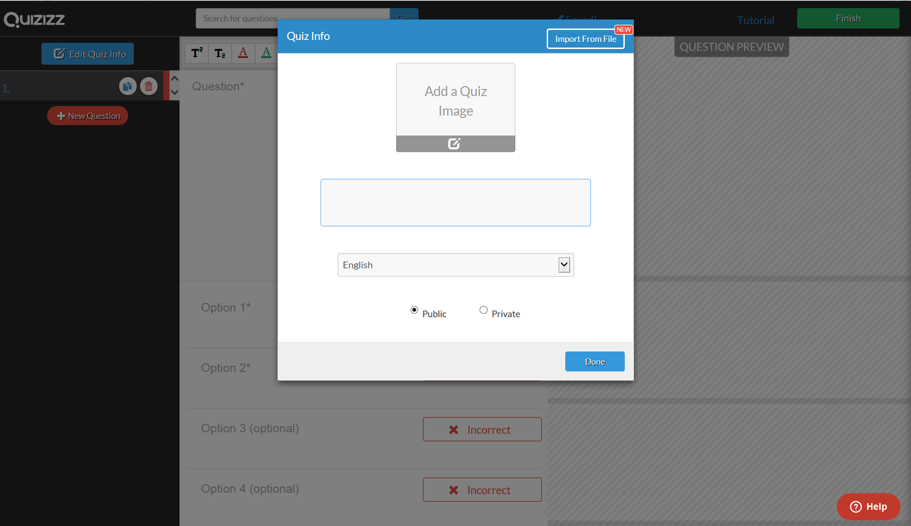

Slide 46
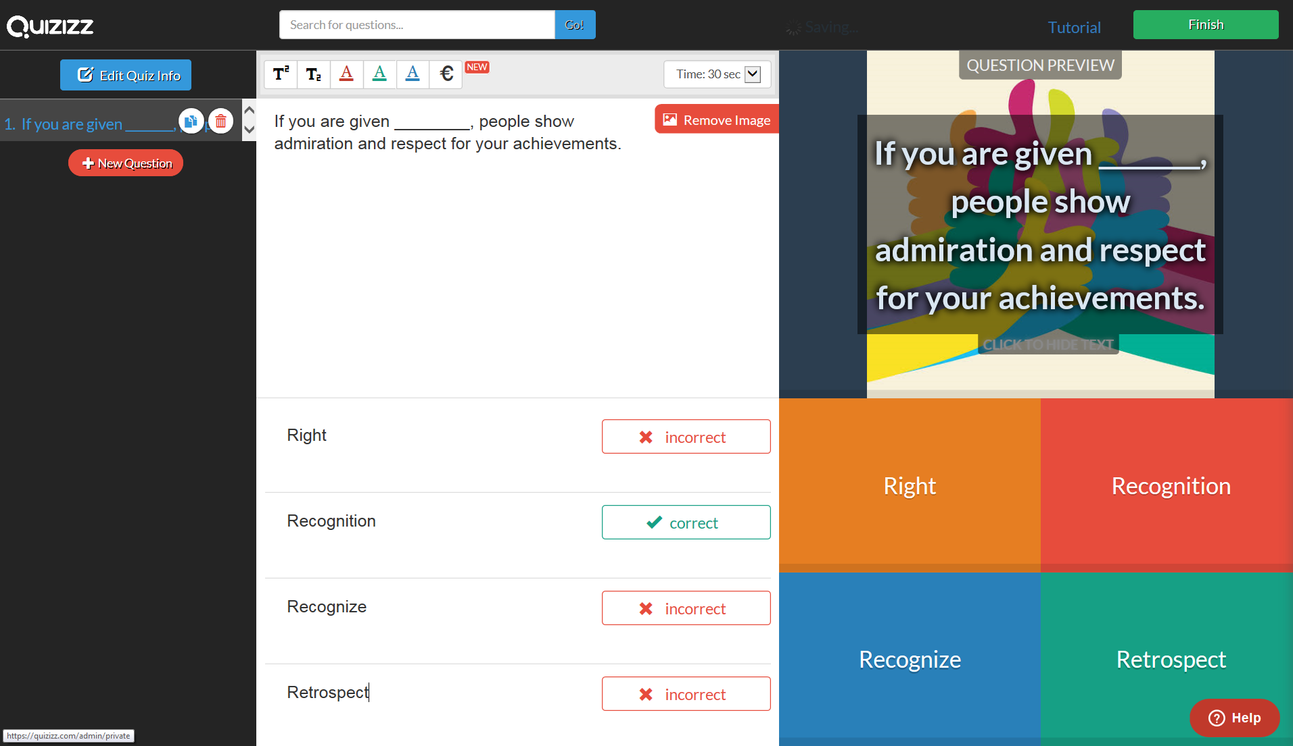

Slide 47
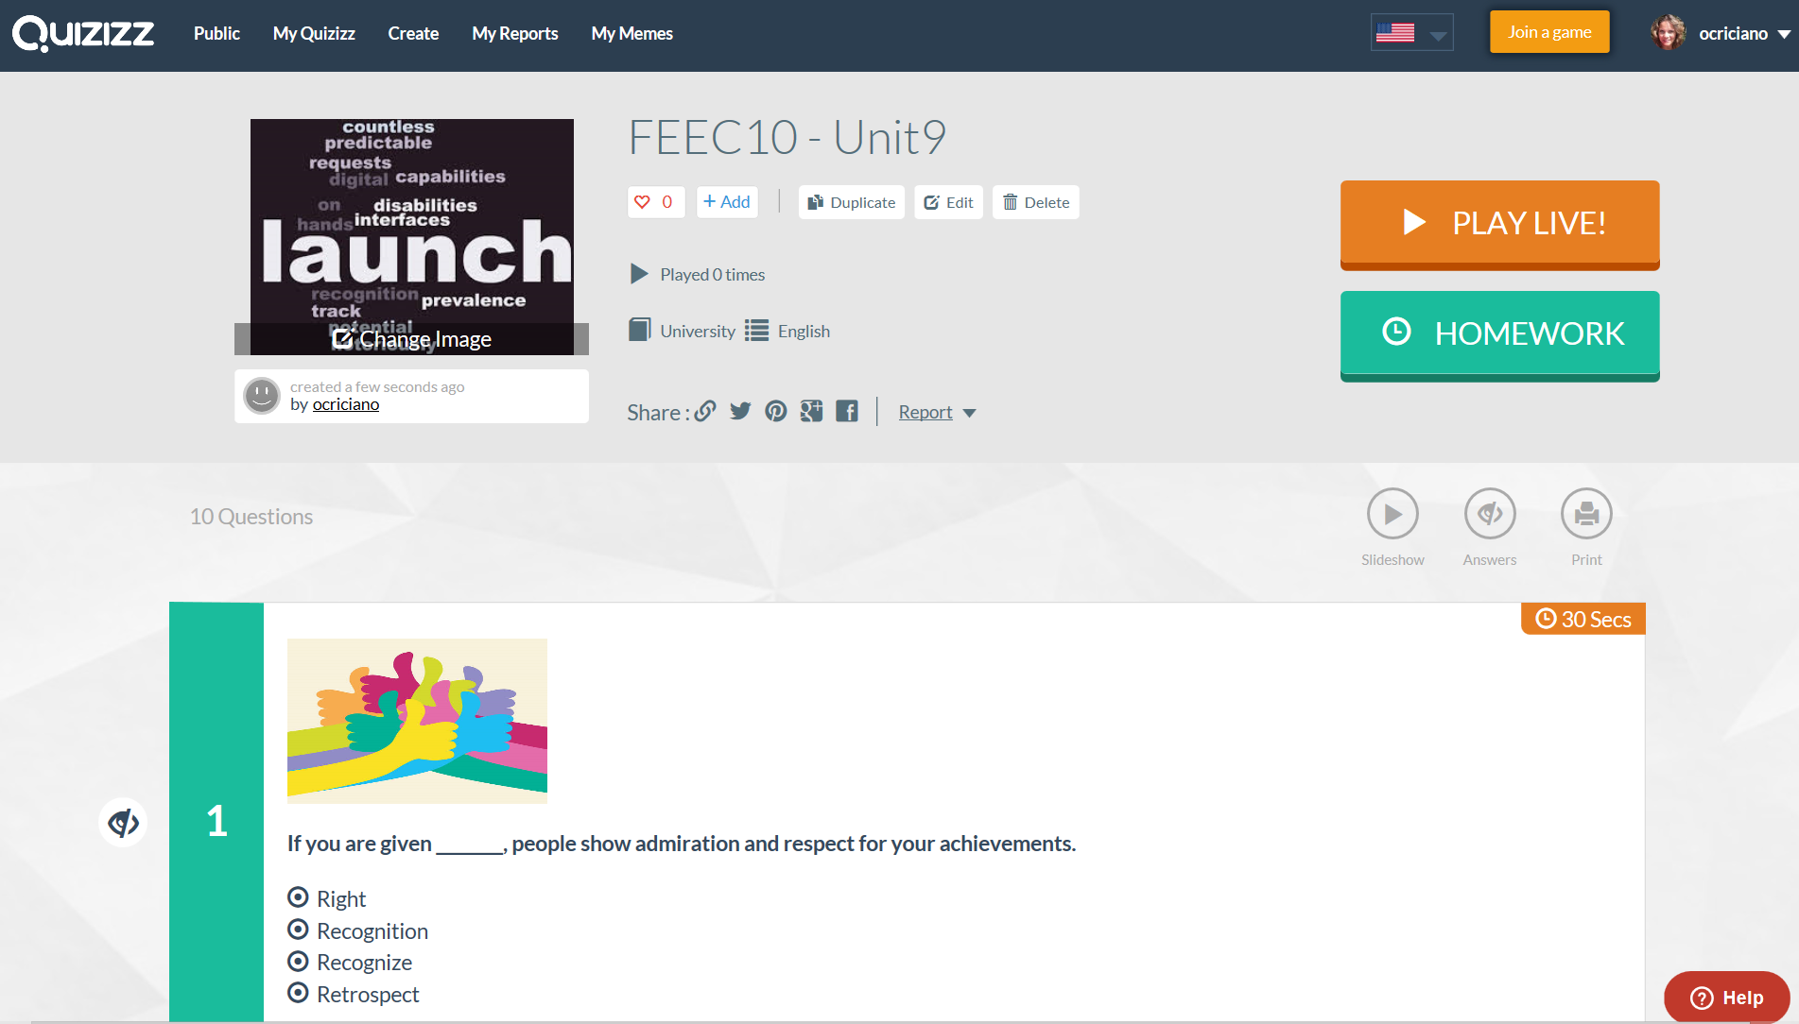

Slide 48
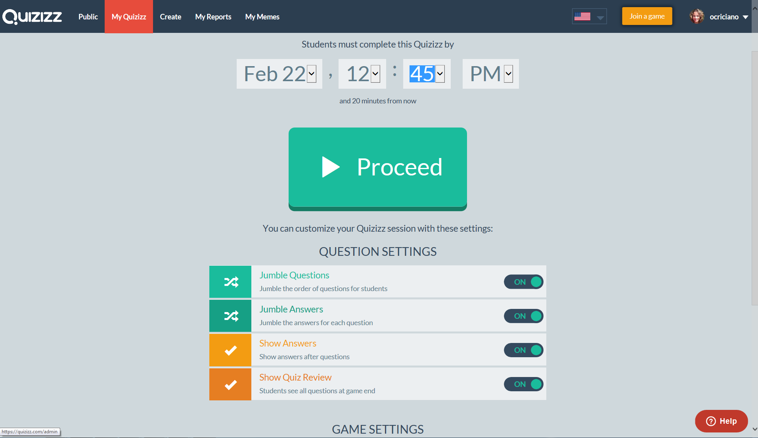
https://quizizz.com/admin/quiz/58aba4384fe42371776cf11d

Slide 49
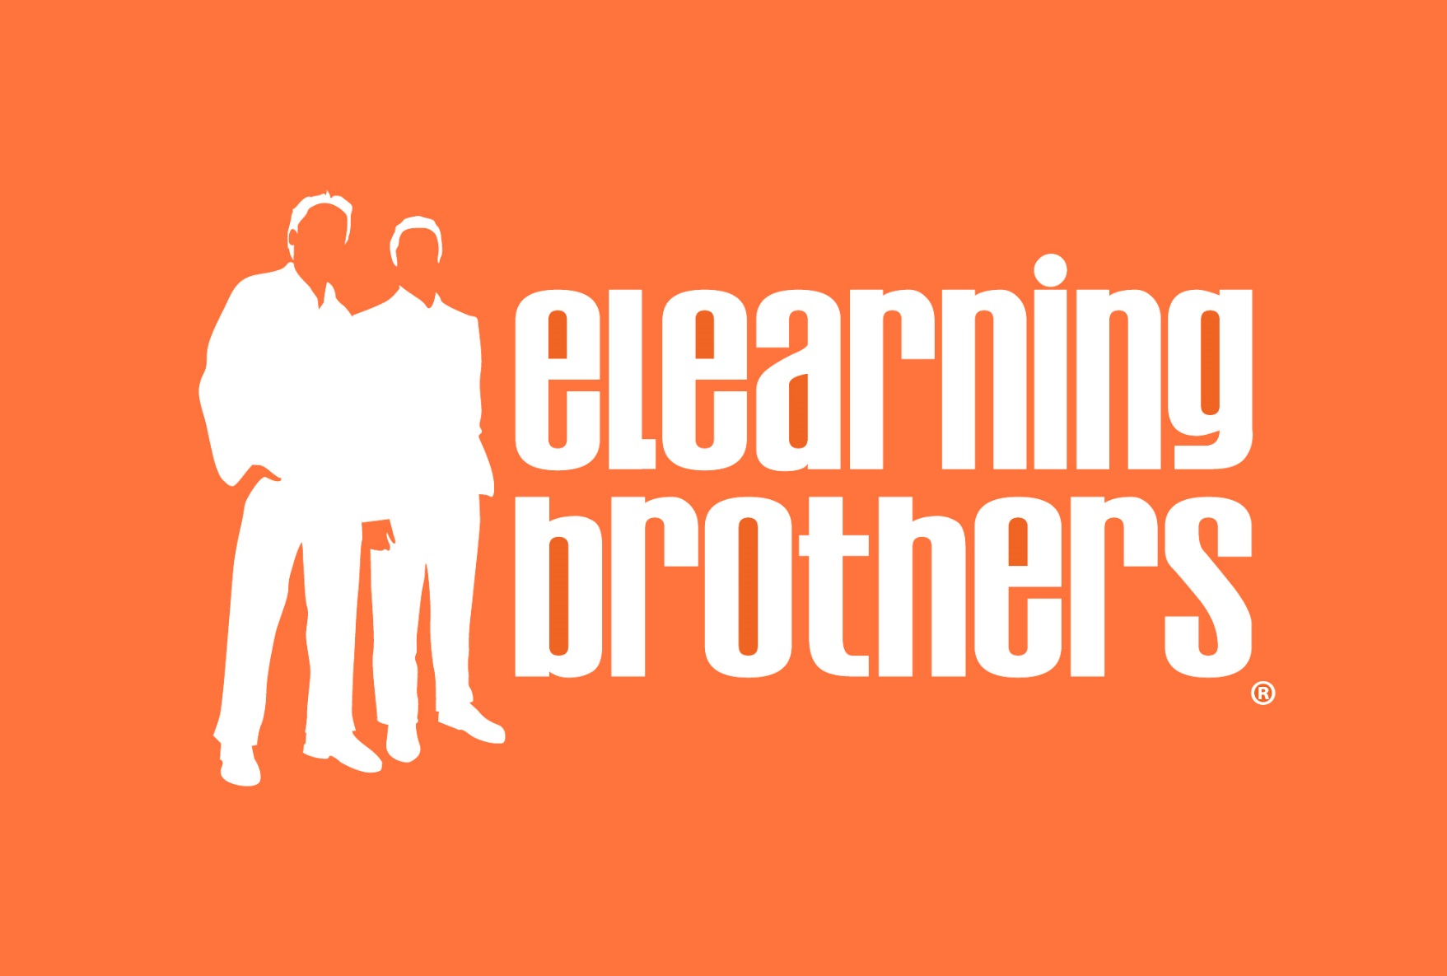

Slide 50
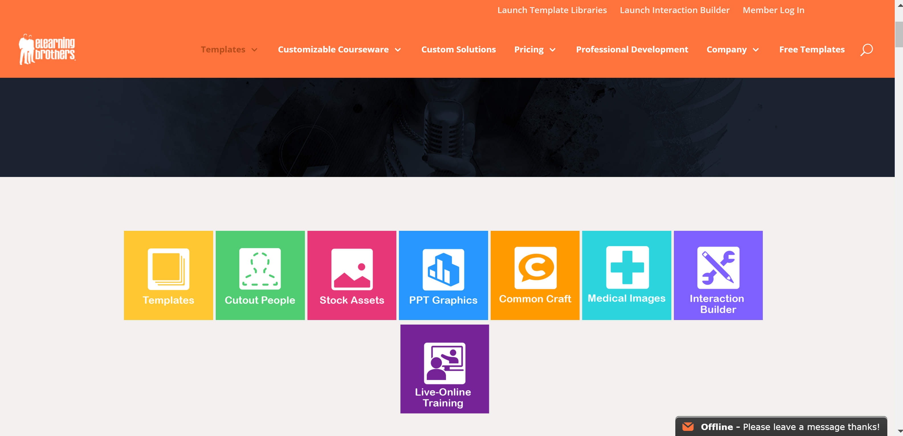

Slide 51
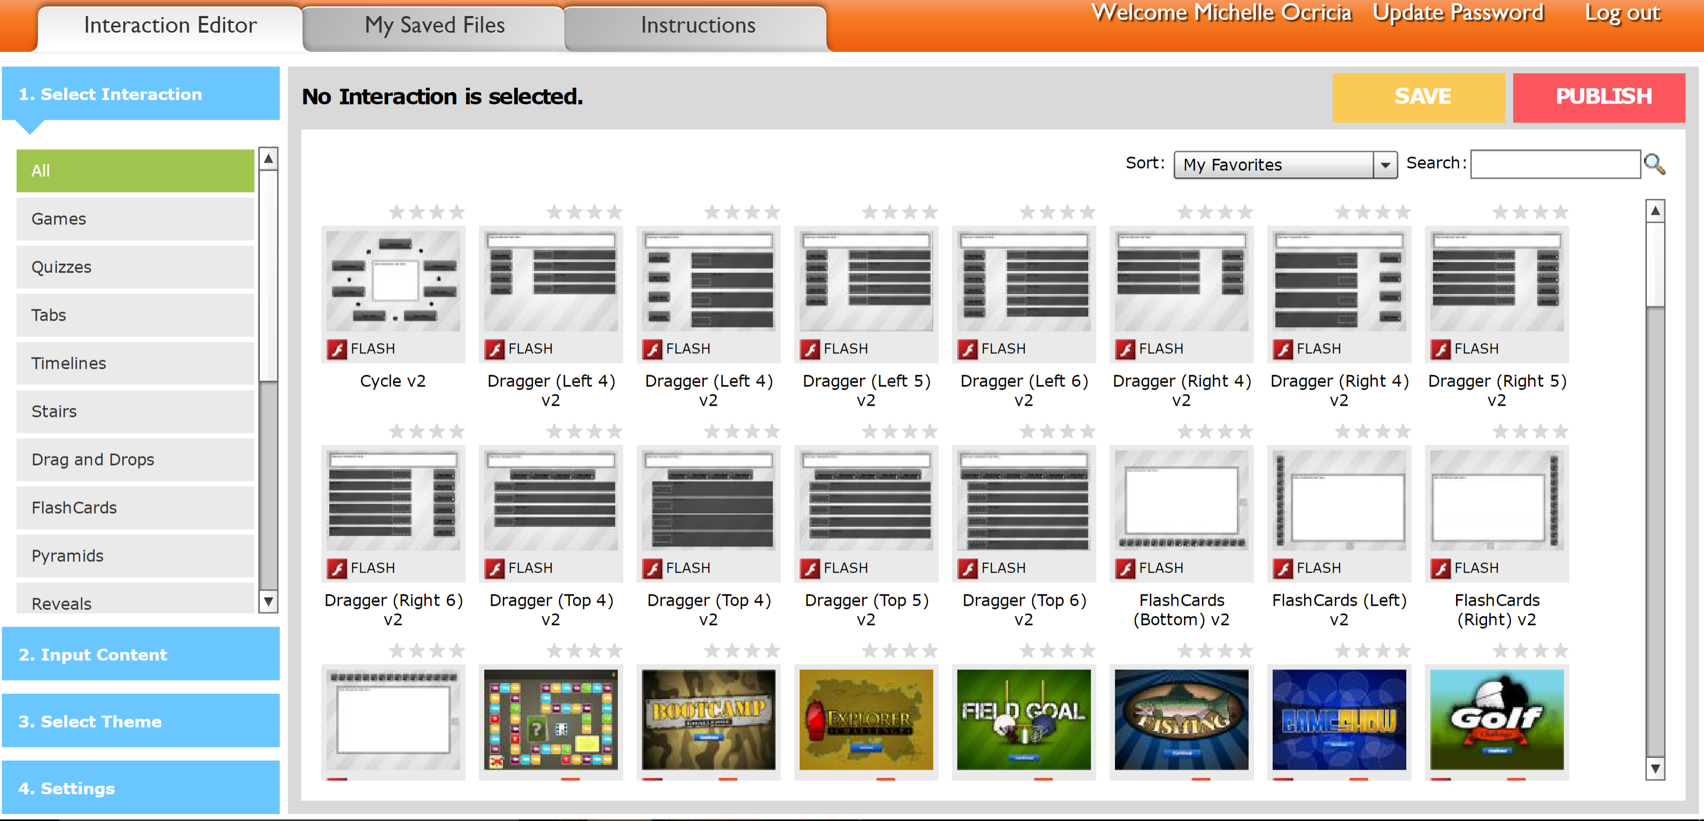

Slide 52
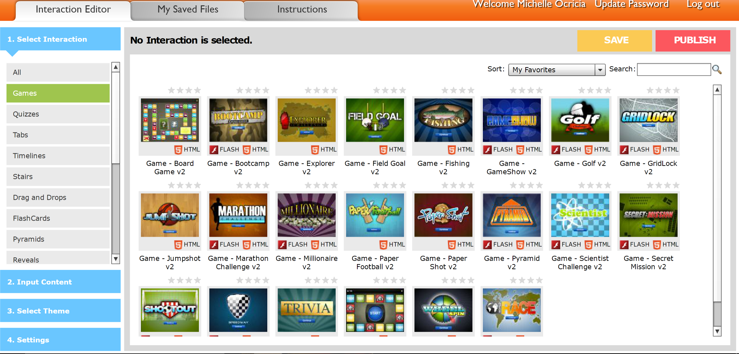

Slide 53
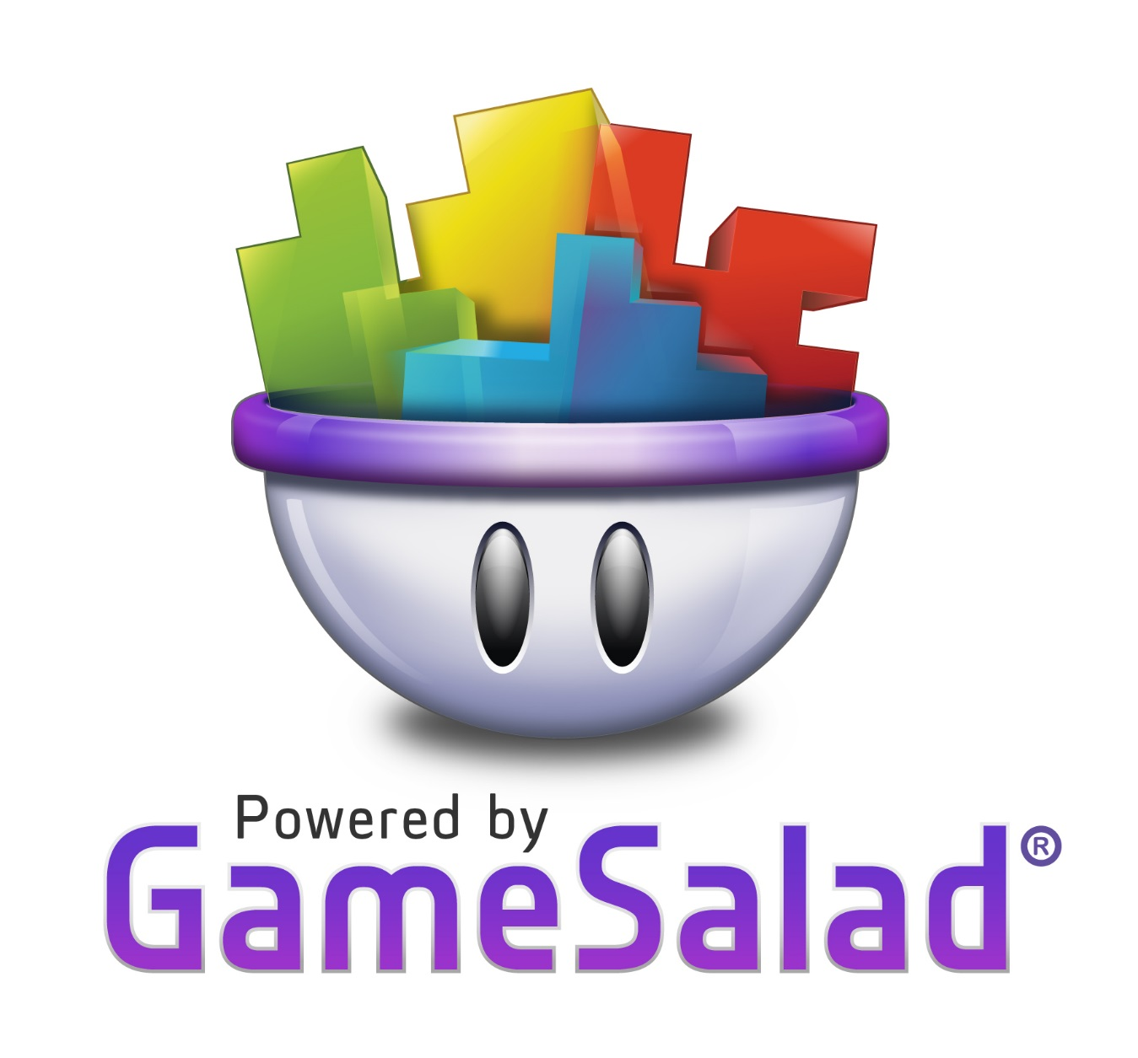

Slide 54
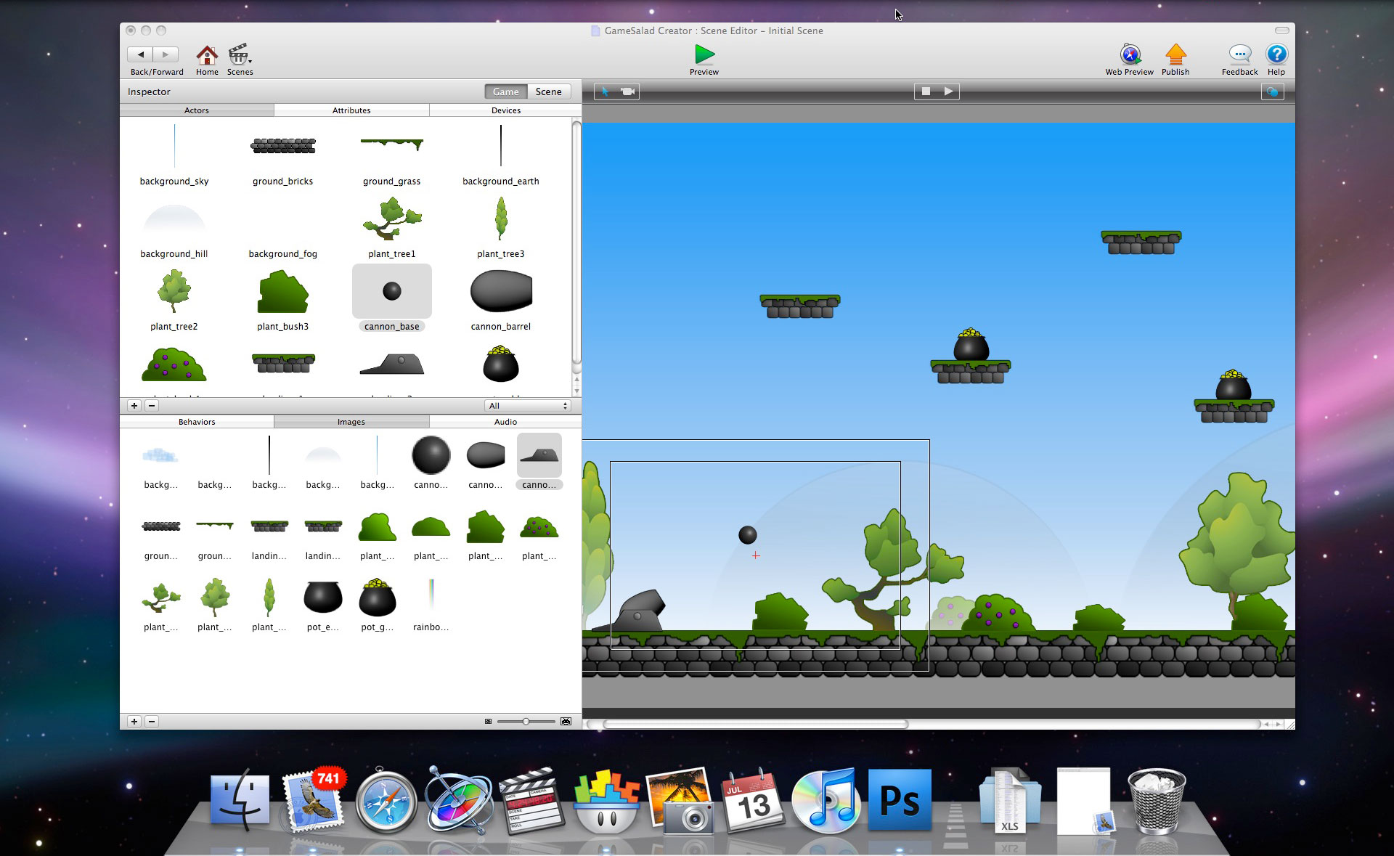

Slide 55
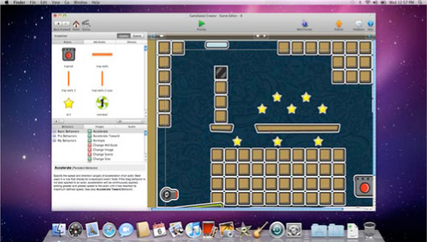

Slide 56
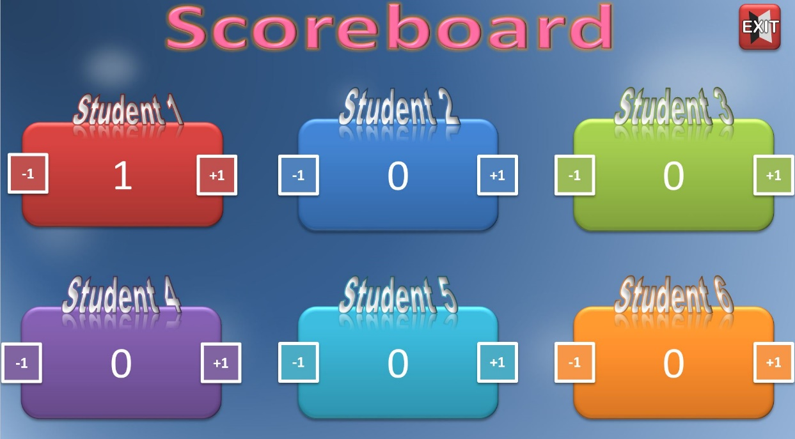
Replicability

Slide 57
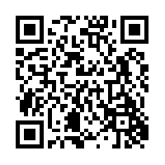
Michelle Ocriciano
m.ocriciano@unswglobal.unsw.edu.au
michelle.ocriciano@gmail.com

Slide 58
Badgeville (2012) About Badgeville. Retrieved from http://www.badgeville.com/abou
Bogost, I (2011) Gamification is bullshit. Retrieved from http://www.bogost.com/blog/gamification_is_bullshit.shtm
Cohen, A (2011, September-October) The gamification of education. The Futurist, 16-17.
Figueroa, J (2015) Using Gamification to Enhance Second Language Learning In: Digital Education Review, 21, 32-54. Retrieved 10/11/2015 http://greav.ub.edu/der
Freire, P (1996) Pedagogy of Freedom. New York, NY: Continuum International Publishing Group
Freire, P (2000) Pedagogy of the oppressed (30th Anniversary ed.). New York, NY: Continuum International Publishing Group
Gamification. In Gamification Wiki. Retrieved May 1, 2015, from http://gamification.org/wiki/Gamification
Gartner Reveals How Gamification Drives Digital Business. (n.d.). Retrieved September 6, 2015, from http://www.gartner.com/newsroom/id/2702117
Rosenkjar, P (2006) “I want to study TOEFL!”: Finding the balance between test focus and language learning in curriculum revision. In T.S.C. Farrell (Ed.), Language teacher research in Asia (pp. 123-140). Alexandria, NJ, TESOL.
Stern, D. M (2011) You had me at Foucault: Living pedagogically in the digital age. Text and performance Quaterly, 31, 249-266.
Kramár, Enikö A et al. “Synaptic Evidence for the Efficacy of Spaced Learning.” Proceedings of the National Academy of Sciences of the United States of America 109.13 (2012): 5121–5126. PMC. Web. 15 May. 2015.
Webner, K (2004) The relationship between student interest and teacher’s use of behavior alteration techniques, Communication Teacher, 21, 82-86.
Werbach, K and Hunter, D (2012) For the Win: How Game Thinking Can Revolutionize Your Business, Philadelphia, PA, Wharton Digital Press.

